Slide 1
TB & HIV Burden Country Analysis Presentation

Slide 2
Project analysis slide 3
TB & HIV Burden Country
Introducation
Data Set Descrition
Data Set Visualization
Conclusion
The dataset contains information on TB and HIV indicators across countries, including prevalence, incidence among HIV-positive individuals, and case detection rates, enabling analysis of disease trends and public health interventions.
The dataset includes TB and HIV data by country, region, and year, facilitating trend analysis and comparisons. It provides insights into TB prevalence, HIV co-infection rates, and case detection rates for public health assessments.
Visualizing the dataset will involve using seaborn and matplotlib to analyze TB and HIV prevalence, estimated TB incidence among HIV-positive cases, and case detection rates across regions and years. This approach will provide insights into trends and relationships, aiding in data understanding and decision-making.
The dataset provides a comprehensive view of TB and HIV metrics, highlighting regional variations and trends over time. It offers valuable insights for public health strategies targeting TB and HIV prevention and control

Slide 3
Project analysis slide 2
Project Analysis
1. Trend Analysis Slide
6. Country / Region Prevalance
Analysis
2. Regional Comparison Slide
5. Case Study Slide
3.Year Detection Slide
4. Correlation Analysis Slide

Slide 4
Project analysis slide 4
1. Trend Analysis Slide
Project Analysis
1.1. Formulating Targeted Public Health Policies And Interventions To Combat Tuberculosis (TB) And HIV Co-infection In Different Regions Or Countries/Territories?
1.1.1) AVG TB & HIV prevalance
TB Avg
Region
AFR 127.915940
AMR 7.207141
EMR 5.845758
EUR 1.203267
SEA 6.778333
WPR 5.117262
HIV Avg
Region
AFR 370.672087
AMR 62.349430
EMR 152.626705
EUR 97.766315
SEA 407.630952
WPR 241.363542

Slide 5
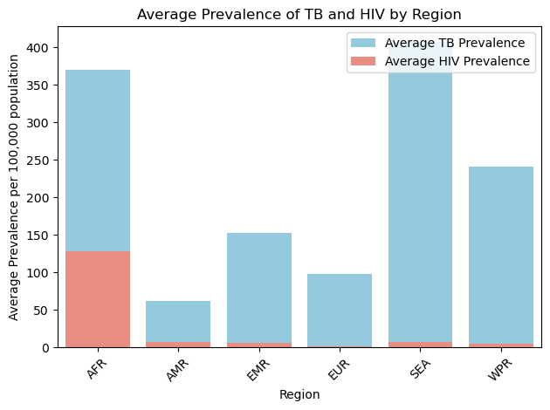
Project analysis slide 5
1. Trend Analysis Slide
1.2. Visualize the average prevalence of TB and HIV-positive cases by region

Slide 6
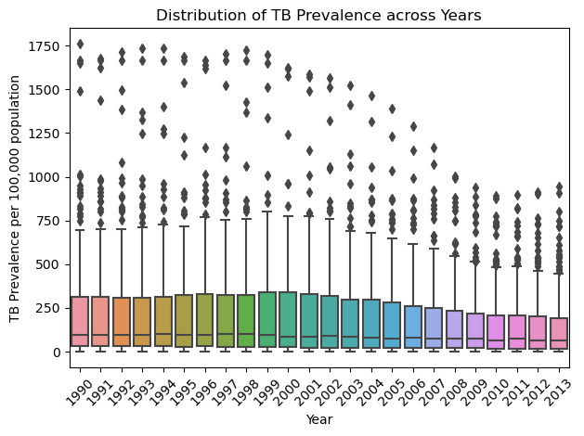
Project analysis slide 5
3.Year Detection Slide
3.1. Dstribuation Of 'TB Prevalence' Across Different Years?

Slide 7
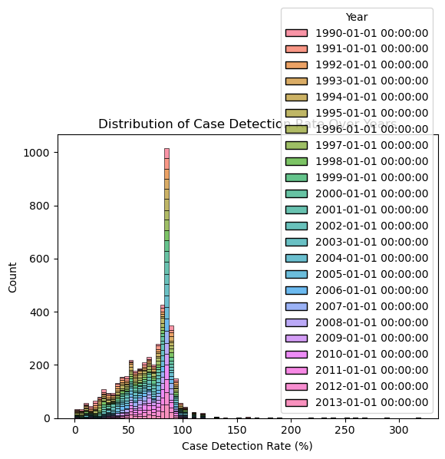
Project analysis slide 5
3.Year Detection Slide
3.3. Distribution Of 'Case Detection Rate (All Forms), Percent' For Different Year

Slide 8
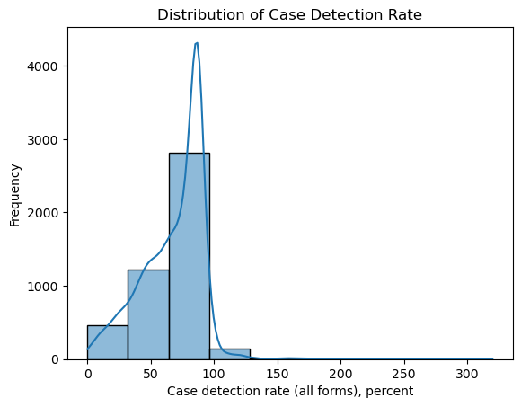
Project analysis slide 5
3.Year Detection Slide
3.4. Case Detection Rate Analysis: Analyzing the distribution of 'Case detection rate (all forms), percent' for different years

Slide 9
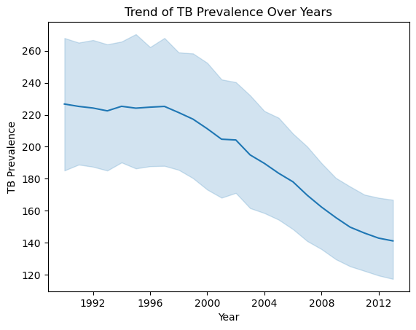
Project analysis slide 5
3.Year Detection Slide
3.5. Trend of TB Prevalence over years

Slide 10
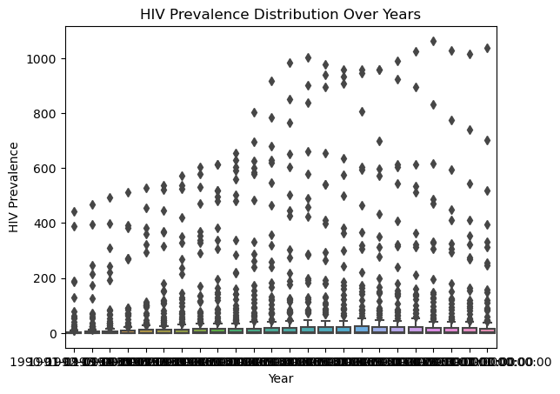
Project analysis slide 5
3.Year Detection Slide
3.6. Comparing HIV Prevalence And Estimated TB Incidence Among Hiv-positive Cases Between Different Years

Slide 11
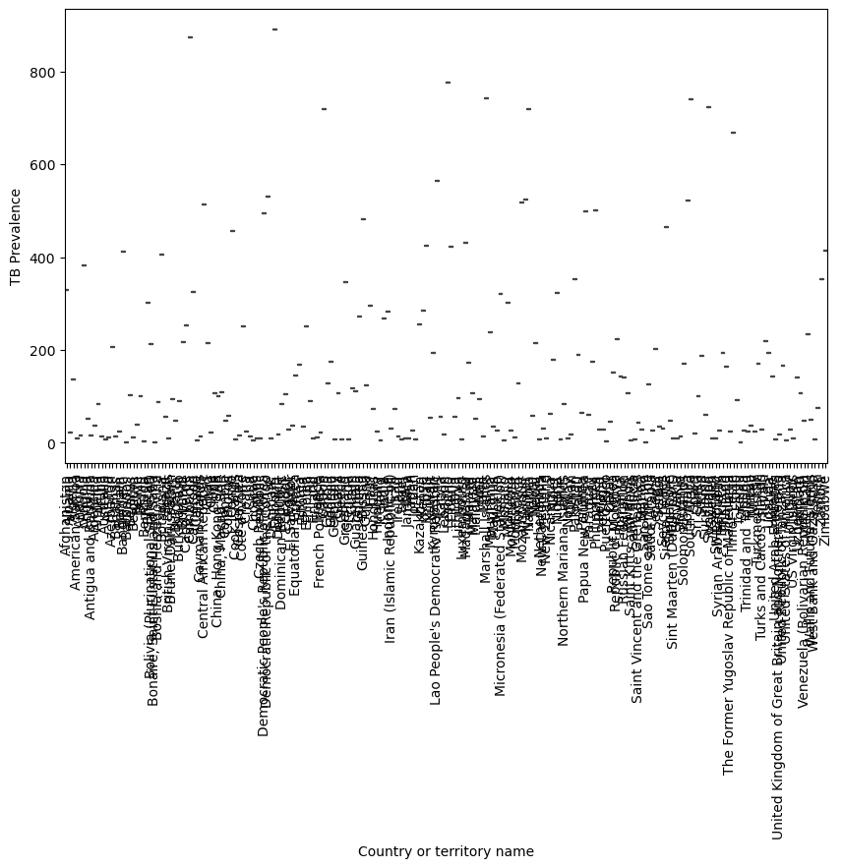
Project analysis slide 5
3.Year Detection Slide
3.7. Average 'Estimated Total Population Number' For Each Country Or Territory

Slide 12
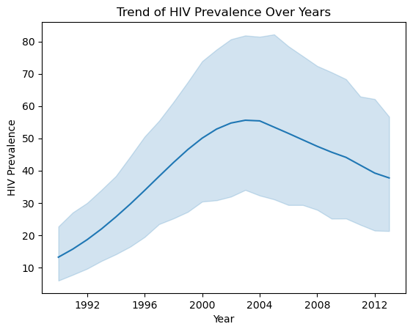
Project analysis slide 5
3.Year Detection Slide
3.8. Trend of HIV Prevalence and Estimated incidence of TB cases who are HIV-positive per 100 000 population over years

Slide 13
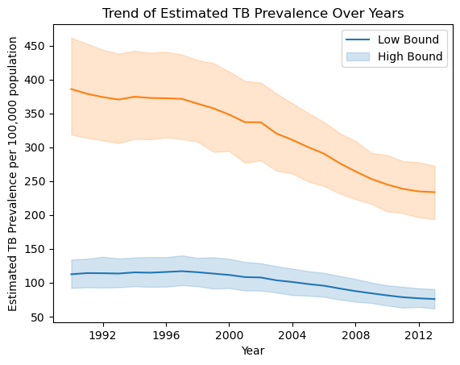
Project analysis slide 5
3.Year Detection Slide
3.8. Trend of Estimated TB Prevalence (low bound and high bound) over years

Slide 14
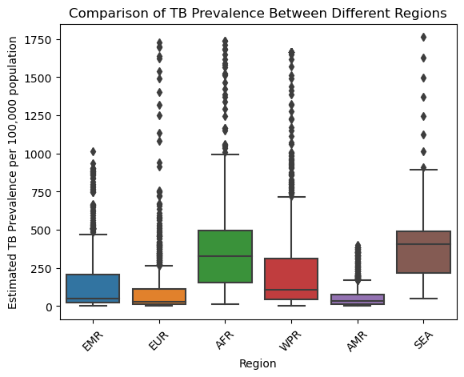
Project analysis slide 5
4. Correlation Analysis Slide
4.1. Comparison of 'Estimated prevalence of TB' between different regions

Slide 15
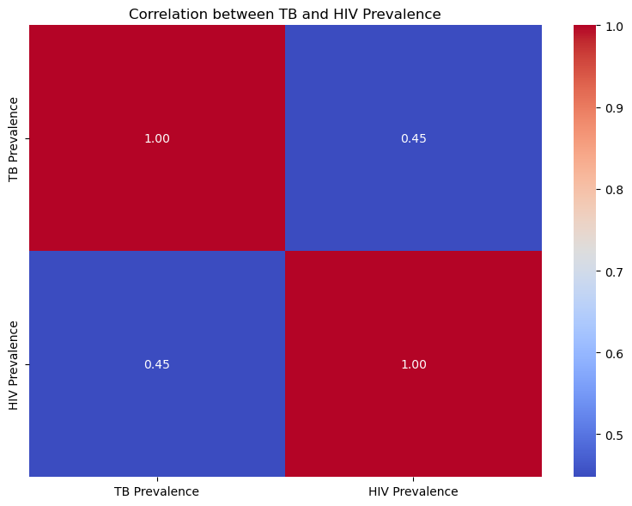
Project analysis slide 5
4. Correlation Analysis Slide
4.2. Analyze correlations between TB and HIV prevalence
TB Prevalence HIV Prevalence
TB Prevalence 1.00000 0.44772
HIV Prevalence 0.44772 1.00000

Slide 16
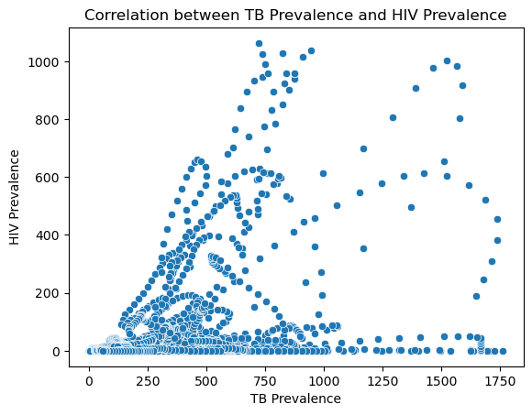
Project analysis slide 5
4. Correlation Analysis Slide
4.3. correlation between 'TB Prevalence' and 'HIV Prevalence' among different countries or territories

Slide 17
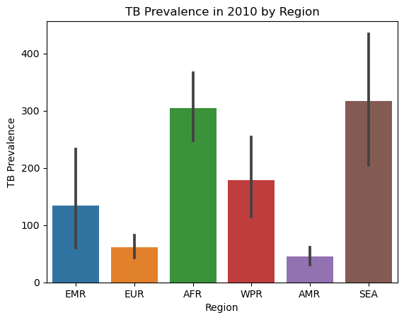
Project analysis slide 5
4. Correlation Analysis Slide
4.4. Regional Comparison: Comparing 'TB Prevalence' between different regions for a specific year (e.g., 2010)

Slide 18
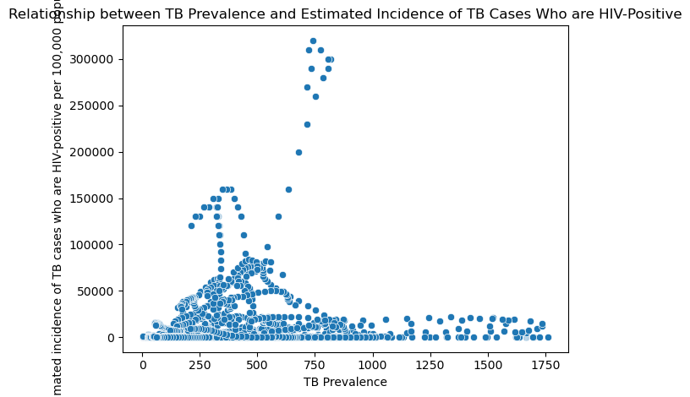
Project analysis slide 5
5. Case Study Slide
5.1. Relationship Between 'TB Prevalence' And 'Estimated Incidence Of TB Cases Who Are Hiv-positive Per 100,000 Population' Using A Scatter Plot

Slide 19
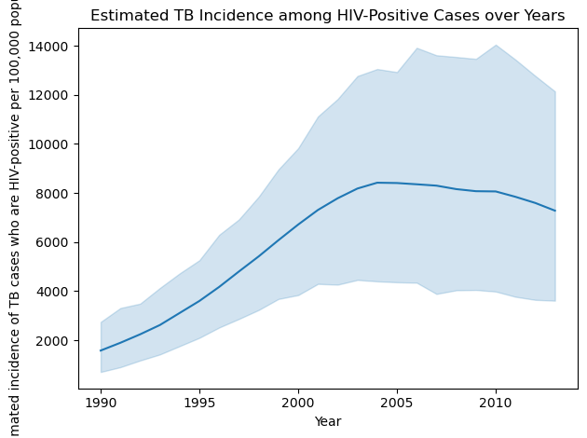
Project analysis slide 5
5. Case Study Slide
5.2. Estimated incidence of TB cases who are HIV-positive per 100,000 population' vary over time

Slide 20
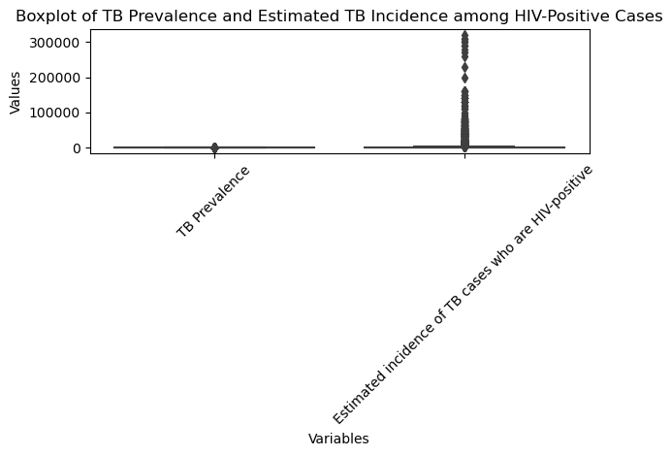
Project analysis slide 5
5. Case Study Slide
5.3. 'TB Prevalence' or 'Estimated incidence of TB cases who are HIV-positive per 100,000 population' columns,

Slide 21
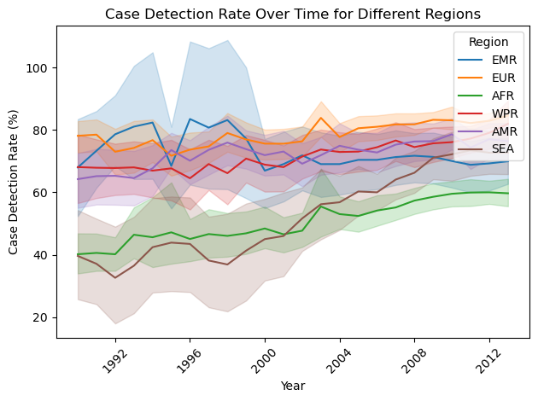
Project analysis slide 5
5. Case Study Slide
5.4. 'Case detection rate (all forms), percent' change over the years for different regions

Slide 22
Project analysis slide 5
5. Case Study Slide
5.5. Population Analysis: Calculating the average 'Estimated total population number' for each region
Average Estimated Total Population Number by Region:
Region
AFR 1.501545e+07
AMR 1.881213e+07
EMR 2.260658e+07
EUR 1.641903e+07
SEA 1.515638e+08
WPR 4.748788e+07
Name: Estimated total population number, dtype: float64

Slide 23
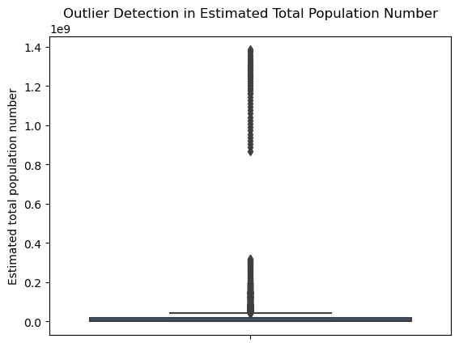
Project analysis slide 5
5. Case Study Slide
5.6. Outlier Detection: Checking For Outliers In 'Estimated Total Population Number' Using Box Plots

Slide 24
Project analysis slide 5
5. Case Study Slide
5.7. Average TB Prevalence for each year
Year
1990-01-01 226.722642
1991-01-01 225.237264
1992-01-01 224.221698
1993-01-01 222.452830
1994-01-01 225.298585
1995-01-01 224.141509
1996-01-01 224.766038
1997-01-01 225.239623
1998-01-01 221.383019
1999-01-01 217.279717
2000-01-01 211.289623
2001-01-01 204.732547
2002-01-01 204.254460
Prevalence, dtype: float64
2003-01-01 194.928685
2004-01-01 189.620376
2005-01-01 183.442523
2006-01-01 178.107944
2007-01-01 169.699533
2008-01-01 162.316822
2009-01-01 155.761215
2010-01-01 149.781019
2011-01-01 146.095714
2012-01-01 142.902535
2013-01-01 141.170323

Slide 25
Project analysis slide 5
5. Case Study Slide
5.8. Countries with High TB And HIV Prevalence
Countries/Territories with High TB and HIV Prevalence:
Country or territory name Region TB Prevalence HIV Prevalence
628 Botswana AFR 949.0 79.0
629 Botswana AFR 975.0 127.0
630 Botswana AFR 992.0 192.0
631 Botswana AFR 987.0 271.0
632 Botswana AFR 961.0 359.0
... ... ... ... ...
5079 Zambia AFR 600.0 530.0
5080 Zambia AFR 579.0 519.0
5081 Zambia AFR 557.0 503.0
5082 Zambia AFR 531.0 485.0
5083 Zambia AFR 504.0 466.0
[185 rows x 4 columns]

Slide 26
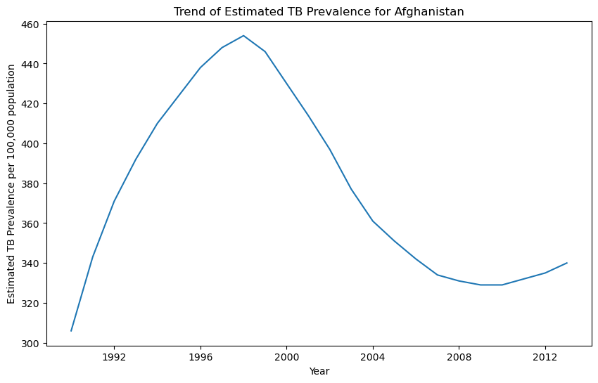
Project analysis slide 5
6. Country Prevalance
6.1. Trend of 'Estimated prevalence of TB' over the years for a specific country or territory (e.g., Afghanistan)

Slide 27
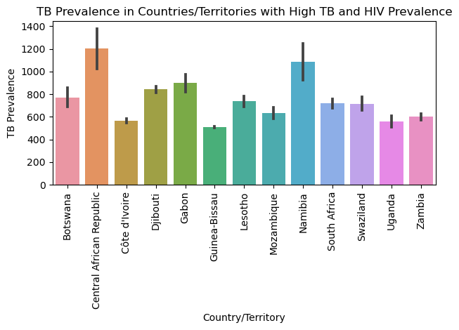
Project analysis slide 5
6. Country Prevalance
6.2. TB Prevalence in countries / territory with hight TB and HIV prevalence

Slide 28
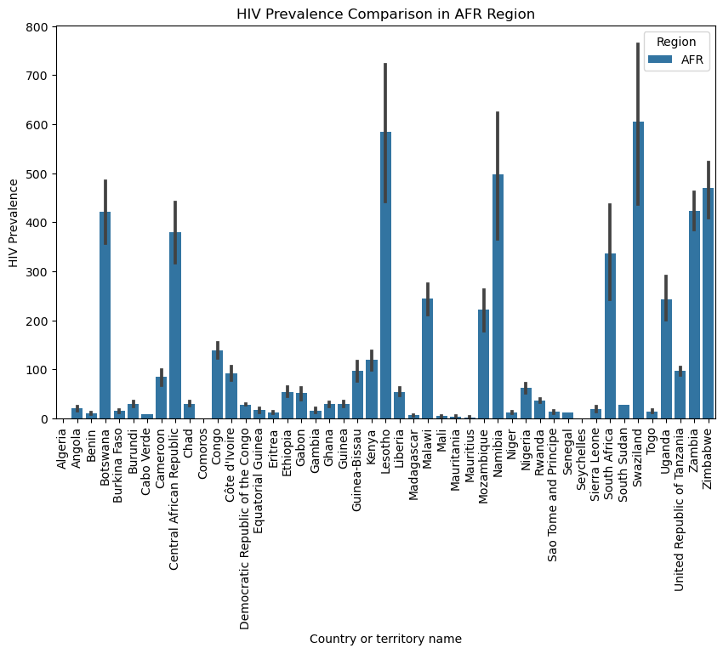
Project analysis slide 5
6. Country / Region Prevalance
6.3. 'HIV Prevalence' compare across different countries or territories in a specific region

Slide 29
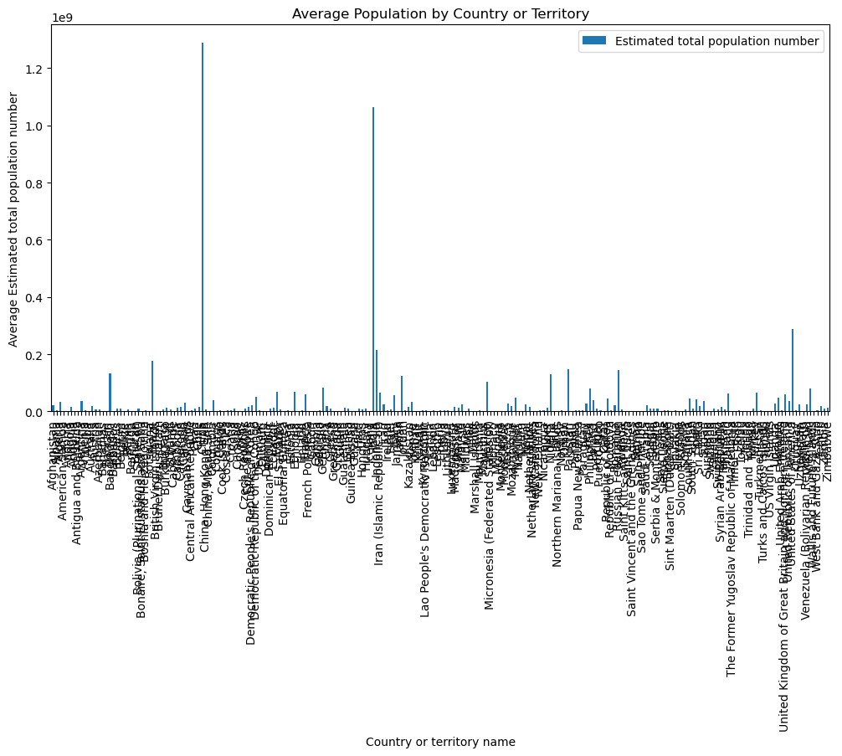
Project analysis slide 5
6. Country Prevalance
6.3. What is the average 'Estimated total population number' for each country or territory

Slide 30
Thank You
Presenting by :- Rutuja Kawade

